Slide 1

Random Networks
MA933 Support Class

Slide 2
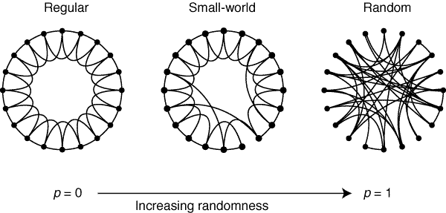
Watts-Strogatz Model
Algorithm:
Begin with a regular ring lattice with n nodes and k edges per node.
With probability p re-wire each edge.

Slide 3
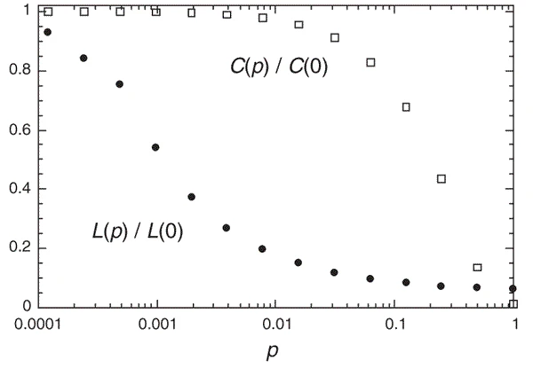
Watts-Strogatz Model
Features:
Short characteristic path length but
high clustering coefficient.
Useful to study how clusters affect dynamics on the network.
Unrealistic degree distribution.
Algorithm:
Begin with a regular ring lattice with n nodes and k edges per node.
With probability p re-wire each edge.

Slide 4
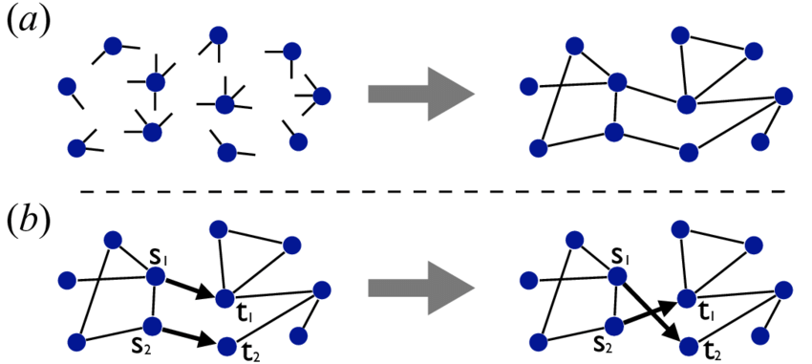
Configuration Model
Algorithm:
Specify the desired degree of each node.
Add the required number of half-edges to each node.
Choose two half-edges uniformly at random and connect them.
Repeat 3 until all half-edges are paired.

Slide 5
Configuration Model
Algorithm:
Specify the desired degree of each node.
Add the required number of half-edges to each node.
Choose two half-edges uniformly at random and connect them.
Repeat 3 until all half-edges are paired.
Advantages:
Complete control over node degrees, which can either be chosen from a given distribution or empirical.
Useful to determine if network properties arise solely from the degree distribution.
Disadvantages:
Must allow self-edges and repeated edges to ensure configuration.

Slide 6

Graphons
Graphs/networks of increasing size
Graphon W(x,y)
Motivation:
To describe the similarity between networks of different sizes with the 'same' structure.
A limiting object for a sequence of networks.
A highly flexible model for generating random networks.

Slide 7
Graphons
Algorithm:
Fix the number of nodes N.
For each i, sample u_{i} uniformly at random in the interval [0,1].
Connect i and j with an edge with probability W(u_{i} u_{j}).

Slide 8
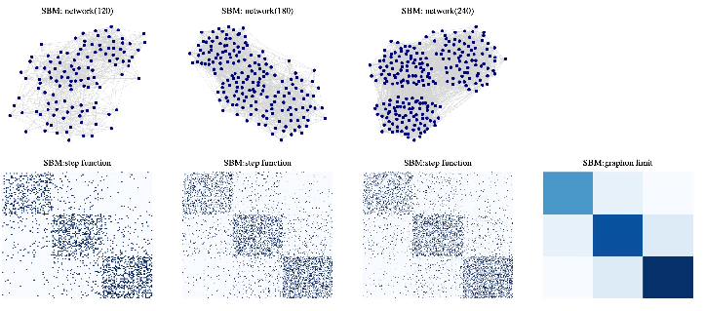
Graphons
Algorithm:
Fix the number of nodes N.
For each i, sample u_{i} uniformly at random in the interval [0,1].
Connect i and j with an edge with probability W(u_{i} u_{j}).
Advantages:
Can create networks of different sizes with the 'same' structure.
Can mimic other models such as ER, Watts-Strogatz and Stochastic Block Models.
Provides a way to study large networks.
Disadvantages:
Only work for dense networks.

